Slide 1
CS162 Operating Systems and Systems Programming Lecture 19 File Systems (Con’t), MMAP, Buffer Cache
April 6th, 2016
Prof. Anthony D. Joseph
http://cs162.eecs.Berkeley.edu

Slide 2
Recall: Building a File System
File System: Layer of OS that transforms block interface of disks (or other block devices) into Files, Directories, etc.
File System Components
Disk Management: collecting disk blocks into files
Naming: Interface to find files by name, not by blocks
Protection: Layers to keep data secure
Reliability/Durability: Keeping of files durable despite crashes, media failures, attacks, etc
User vs. System View of a File
User’s view:
Durable Data Structures
System’s view (system call interface):
Collection of Bytes (UNIX)
Doesn’t matter to system what kind of data structures you want to store on disk!
System’s view (inside OS):
Collection of blocks (a block is a logical transfer unit, while a sector is the physical transfer unit)
Block size ≥ sector size; in UNIX, block size is 4KB

Slide 3
Recall: Components of a File System
File path
Directory
Structure
File Index
Structure
One Block = multiple sectors
Ex: 512 sector, 4K block
File number
“inumber”
Data blocks
“inode”
…

Slide 4
Recall: Components of a file system
file name
offset
file number
offset
Storage block
directory
index structure
Open performs Name Resolution
Translates pathname into a “file number”
Used as an “index” to locate the blocks
Creates a file descriptor in PCB within kernel
Returns a “handle” (another integer) to user process
Read, Write, Seek, and Sync operate on handle
Mapped to descriptor and to blocks

Slide 5
Recall: FAT (File Allocation Table) filesystem
The most commonly used filesystem in the world!
Assume (for now) we have a way to translate a path to a “file number”
i.e., a directory structure
Disk Storage is a collection of Blocks
Just hold file data
Example: file_read 31, < 2, x >
Index into FAT with file number
Follow linked list to block
Read the block from disk into memory
FAT
Disk Blocks
file number
0:
0:
31:
File 31, Block 0
File 31, Block 1
File 31, Block 2
N-1:
N-1:
mem

Slide 6
So What About a “Real” File System?
Meet the inode:
file_number

Slide 7
Unix File System
Original inode format appeared in BSD 4.1
Berkeley Standard Distribution Unix
Part of your heritage!
Similar structure for Linux Ext2/3
File Number is index into inode arrays
Multi-level index structure
Great for little and large files
Asymmetric tree with fixed sized blocks
Metadata associated with the file
Rather than in the directory that points to it
UNIX FFS: BSD 4.2: Locality Heuristics
Block group placement
Reserve space
Scalable directory structure

Slide 8
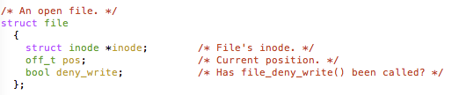
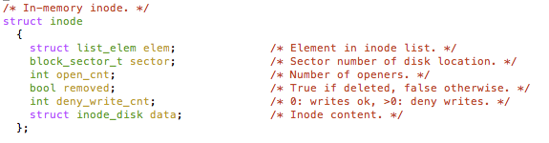
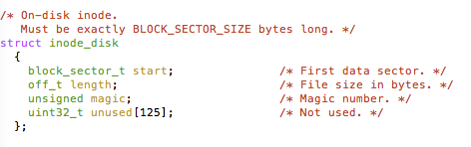
An “Almost Real” File System
Pintos: src/filesys/file.c, inode.c
file_number

Slide 9
File Attributes
Inode metadata
User
Group
9 basic access control bits
- UGO x RWX
Setuid bit
- execute at owner permissions
- rather than user
Getgid bit
- execute at group’s permissions

Slide 10
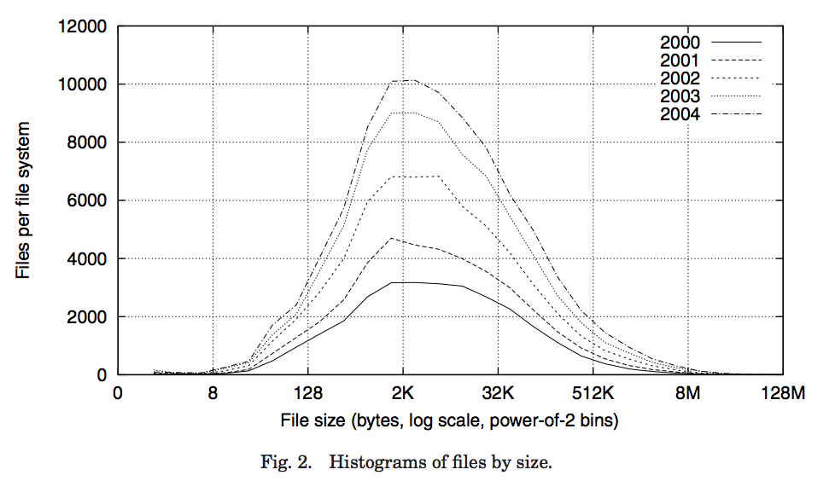
Data Storage
Small files: 12 pointers direct to data blocks
Direct pointers
4kB blocks ⇒ sufficient For files up to 48KB

Slide 11
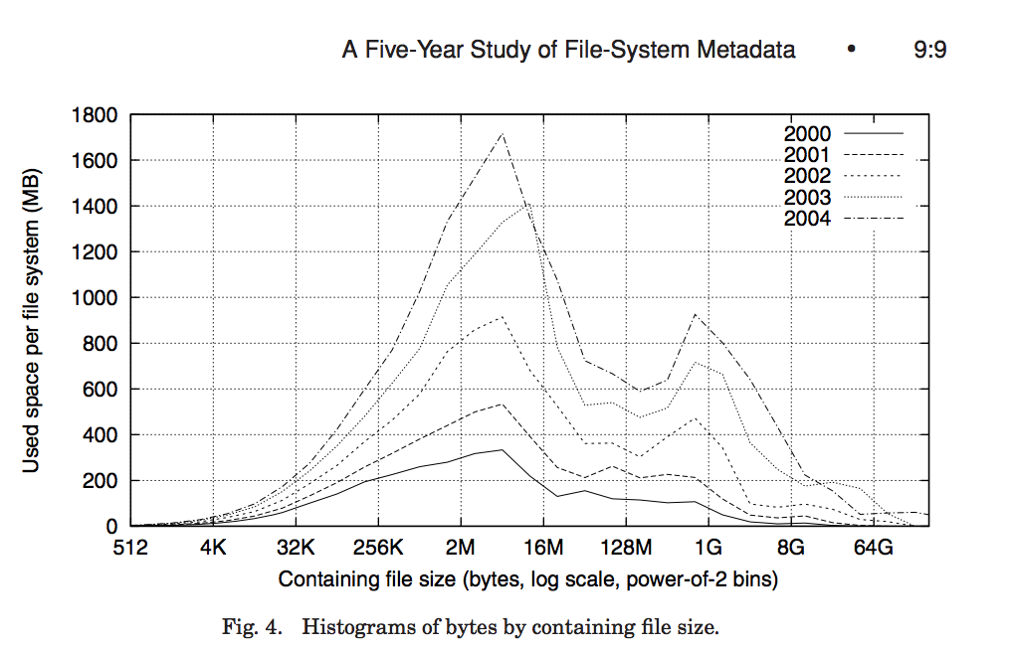
Data Storage
Large files: 1,2,3 level indirect pointers
Indirect pointers
- point to a disk block
containing only pointers
- 4 kB blocks => 1024 ptrs
=> 4 MB @ level 2
=> 4 GB @ level 3
=> 4 TB @ level 4
48 KB
+4 MB
+4 GB
+4 TB

Slide 12
UNIX BSD 4.2
Same as BSD 4.1 (same file header and triply indirect blocks), except incorporated ideas from Cray Operating System:
Uses bitmap allocation in place of freelist
Attempt to allocate files contiguously
10% reserved disk space
Skip-sector positioning (mentioned next slide)
Problem: When create a file, don’t know how big it will become (in UNIX, most writes are by appending)
How much contiguous space do you allocate for a file?
In BSD 4.2, just find some range of free blocks
Put each new file at the front of different range
To expand a file, you first try successive blocks in bitmap, then choose new range of blocks
Also in BSD 4.2: store files from same directory near each other
Fast File System (FFS)
Allocation and placement policies for BSD 4.2

Slide 13
Attack of the Rotational Delay
Problem 2: Missing blocks due to rotational delay
Issue: Read one block, do processing, and read next block. In meantime, disk has continued turning: missed next block! Need 1 revolution/block!
Solution1: Skip sector positioning (“interleaving”)
Place the blocks from one file on every other block of a track: give time for processing to overlap rotation
Solution2: Read ahead: read next block right after first, even if application hasn’t asked for it yet.
This can be done either by OS (read ahead)
By disk itself (track buffers) - many disk controllers have internal RAM that allows them to read a complete track
Important Aside: Modern disks + controllers do many complex things “under the covers”
Track buffers, elevator algorithms, bad block filtering
Skip Sector
Track Buffer
(Holds complete track)

Slide 14
Where are inodes Stored?
In early UNIX and DOS/Windows’ FAT file system, headers stored in special array in outermost cylinders
Header not stored anywhere near the data blocks
To read a small file, seek to get header, seek back to data
Fixed size, set when disk is formatted
At formatting time, a fixed number of inodes are created
Each is given a unique number, called an “inumber”

Slide 15
Where are inodes Stored?
Later versions of UNIX moved the header information to be closer to the data blocks
Often, inode for file stored in same “cylinder group” as parent directory of the file (makes an ls of that directory run fast)
Pros:
UNIX BSD 4.2 puts bit of file header array on many cylinders
For small directories, can fit all data, file headers, etc. in same cylinder ⇒ no seeks!
File headers much smaller than whole block (a few hundred bytes), so multiple headers fetched from disk at same time
Reliability: whatever happens to the disk, you can find many of the files (even if directories disconnected)
Part of the Fast File System (FFS)
General optimization to avoid seeks

Slide 16
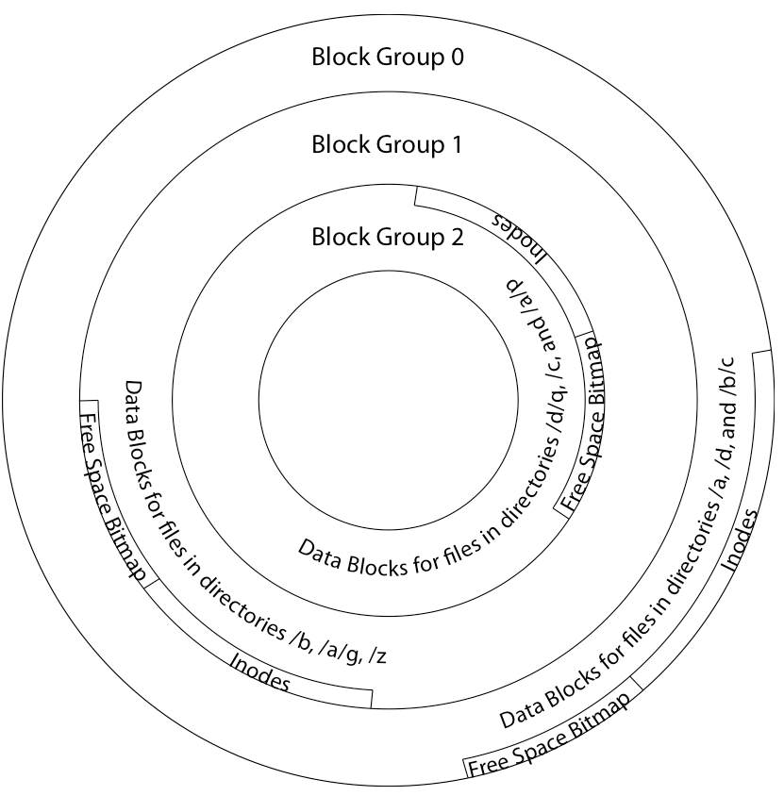
4.2 BSD Locality: Block Groups
File system volume is divided into a set of block groups
Close set of tracks
Data blocks, metadata, and free space interleaved within block group
Avoid huge seeks between user data and system structure
Put directory and its files in common block group
First-Free allocation of new file blocks
To expand file, first try successive blocks in bitmap, then choose new range of blocks
Few little holes at start, big sequential runs at end of group
Avoids fragmentation
Sequential layout for big files
Important: keep 10% or more free!
Reserve space in the Block Group

Slide 17
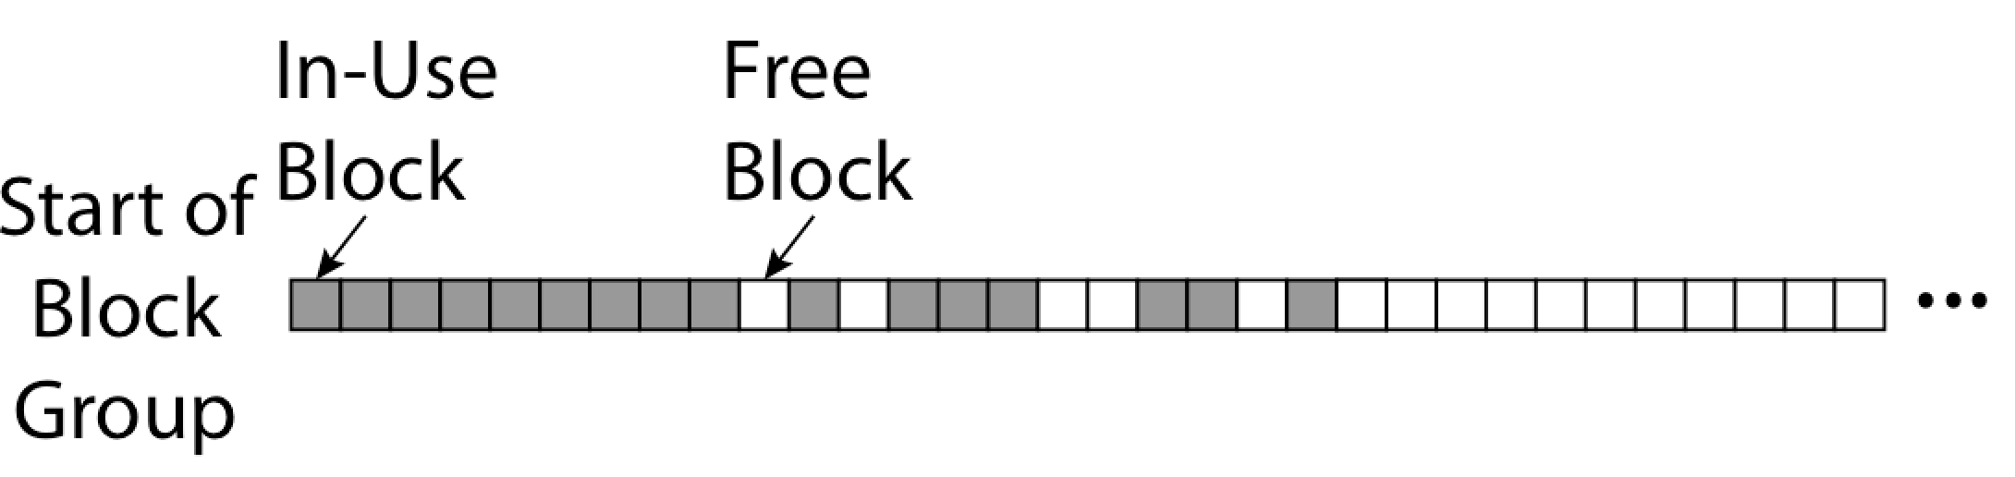
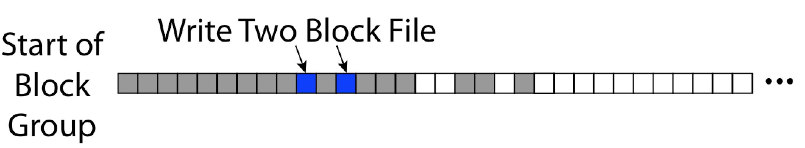
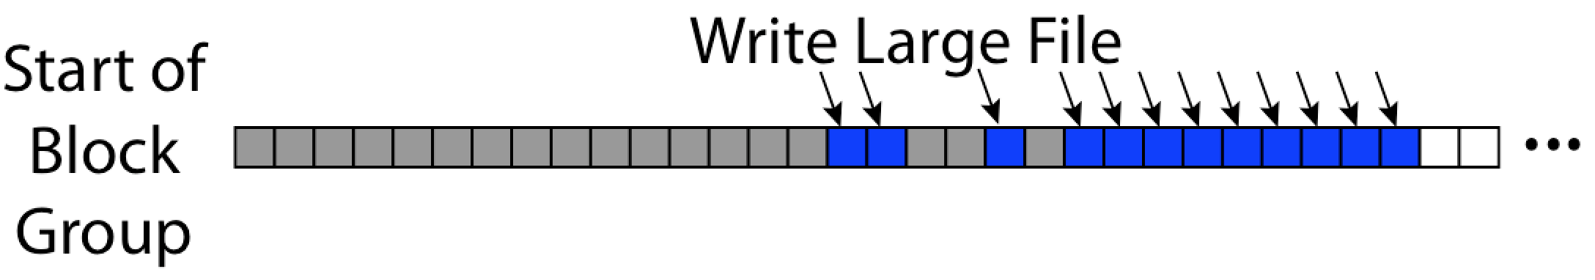
UNIX 4.2 BSD FFS First Fit Block Allocation
Fills in the small holes at the start of block group
Avoids fragmentation, leaves contiguous free space at end

Slide 18
UNIX 4.2 BSD FFS
Pros
Efficient storage for both small and large files
Locality for both small and large files
Locality for metadata and data
Cons
Inefficient for tiny files (a 1 byte file requires both an inode and a data block)
Inefficient encoding when file is mostly contiguous on disk
Need to reserve 10-20% of free space to prevent fragmentation

Slide 19
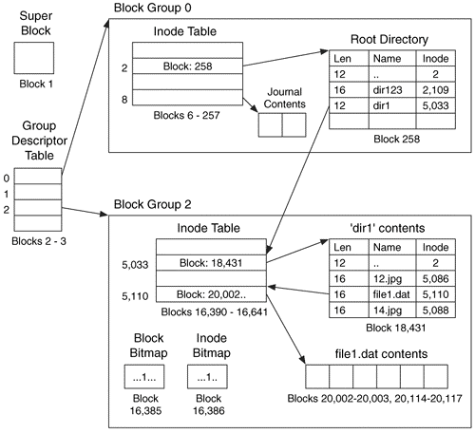
Linux Example: Ext2/3 Disk Layout
Disk divided into block groups
Provides locality
Each group has two block-sized bitmaps (free blocks/inodes)
Block sizes settable at format time: 1K, 2K, 4K, 8K…
Actual inode structure similar to 4.2 BSD
with 12 direct pointers
Ext3: Ext2 with Journaling
Several degrees of protection with comparable overhead
Example: create a file1.dat under /dir1/ in Ext3

Slide 20
A bit more on directories
Stored in files, can be read, but typically don’t
System calls to access directories
Open / Creat traverse the structure
mkdir /rmdir add/remove entries
Link / Unlink
Link existing file to a directory
Not in FAT !
Forms a DAG
When can file be deleted?
Maintain ref-count of links to the file
Delete after the last reference is gone
libc support
DIR * opendir (const char *dirname)
struct dirent * readdir (DIR *dirstream)
int readdir_r (DIR *dirstream, struct dirent *entry, struct dirent **result)
/usr
/usr/lib
/usr/lib4.3
/usr/lib/foo
/usr/lib4.3/foo

Slide 21
Links
Hard link
Sets another directory entry to contain the file number for the file
Creates another name (path) for the file
Each is “first class”
Soft link or Symbolic Link
Directory entry contains the name of the file
Map one name to another name

Slide 22
Large Directories: B-Trees (dirhash)

Slide 23
NTFS
New Technology File System (NTFS)
Common on Microsoft Windows systems
Variable length extents
Rather than fixed blocks
Everything (almost) is a sequence of <attribute:value> pairs
Meta-data and data
Mix direct and indirect freely
Directories organized in B-tree structure by default

Slide 24
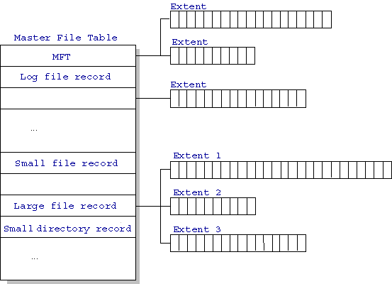
NTFS
Master File Table
Database with Flexible 1KB entries for metadata/data
Variable-sized attribute records (data or metadata)
Extend with variable depth tree (non-resident)
Extents – variable length contiguous regions
Block pointers cover runs of blocks
Similar approach in Linux (ext4)
File create can provide hint as to size of file
Journaling for reliability
Discussed later
http://ntfs.com/ntfs-mft.htm

Slide 25
NTFS Small File
Create time, modify time, access time,
Owner id, security specifier, flags (RO, hidden, sys)
data attribute
Attribute list

Slide 26
NTFS Medium File

Slide 27
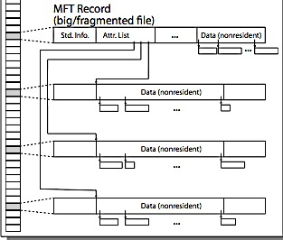
NTFS Multiple Indirect Blocks

Slide 29
Memory Mapped Files
Traditional I/O involves explicit transfers between buffers in process address space to regions of a file
This involves multiple copies into caches in memory, plus system calls
What if we could “map” the file directly into an empty region of our address space
Implicitly “page it in” when we read it
Write it and “eventually” page it out
Executable file is treated this way when we exec the process !!

Slide 30
Recall: Who Does What, When?
Process
virtual address
physical address
MMU
page#
PT
instruction
frame#
retry
page fault
offset
exception
frame#
Operating System
offset
update PT entry
Page Fault Handler
load page from disk
scheduler

Slide 31
Using Paging to mmap() Files
Process
virtual address
physical address
MMU
page#
PT
instruction
frame#
offset
retry
page fault
exception
Read File contents
from memory!
Operating System
Create PT entries
for mapped region
as “backed” by file
Page Fault Handler
File
scheduler
mmap file to region of VAS

Slide 32
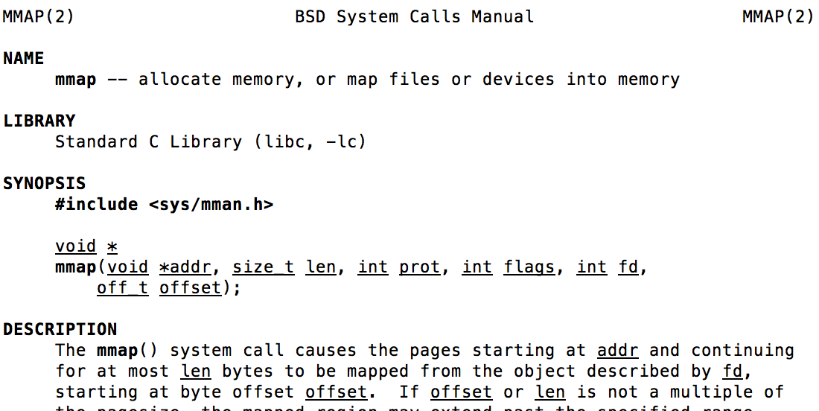
mmap() system call
May map a specific region or let the system find one for you
Tricky to know where the holes are
Used both for manipulating files and for sharing between processes

Slide 33
An Example
#include <sys/mman.h>
int something = 162;
int main (int argc, char *argv[]) {
int myfd;
char *mfile;
printf("Data at: %16lx\n", (long unsigned int) &something);
printf("Heap at : %16lx\n", (long unsigned int) malloc(1));
printf("Stack at: %16lx\n", (long unsigned int) &mfile);
/* Open the file */
myfd = open(argv[1], O_RDWR | O_CREATE);
if (myfd < 0) { perror((“open failed!”);exit(1); }
/* map the file */
mfile = mmap(0, 10000, PROT_READ|PROT_WRITE, MAP_FILE|MAP_SHARED, myfd, 0);
if (mfile == MAP_FAILED) {perror("mmap failed"); exit(1);}
printf("mmap at : %16lx\n", (long unsigned int) mfile);
puts(mfile);
strcpy(mfile+20,"Let's write over it");
close(myfd);
return 0;
}

Slide 34
Sharing through Mapped Files
VAS 1
VAS 2
0x000…
0x000…
instructions
instructions
data
data
File
heap
heap
Memory
stack
stack
OS
OS
0xFFF…
0xFFF…
Also: anonymous memory between parents and children
no file backing – just swap space

Slide 35
System-V-style Shared Memory
Common chunk of read/write memory among processes
MAX
Shared Memory
(unique key)
Create
ptr
ptr
Attach
0
Attach
Proc. 1
Proc. 2
ptr
ptr
ptr
Proc. 3
Proc. 4
Proc. 5

Slide 36
Creating Shared Memory
// Create new segment
int shmget(key_t key, size_t size, int shmflg);
Example:
key_t key;
int shmid;
key = ftok(“<somefile>", ‘A');
shmid = shmget(key, 1024, 0644 | IPC_CREAT);
Special key: IPC_PRIVATE (create new segment)
Flags: IPC_CREAT (Create new segment)
IPC_EXCL (Fail if segment with key already exists)
lower 9 bits – permissions use on new segment
Filename only used to generate key – not for storage

Slide 37
Attach and Detach Shared Memory
// Attach
void *shmat(int shmid, void *shmaddr, int shmflg);
Flags: SHM_RDONLY, SHM_REMAP
// Detach
int shmdt(void *shmaddr);
Example:
key_t key;
int shmid;
char *sharedmem;
key = ftok("<somefile>", ‘A');
shmid = shmget(key, 1024, 0644);
sharedmem = shmat(shmid, (void *)0, 0); // Attach smem
// Use shared memory segment (address is in sharedmem)
…
shmdt(sharedmem); // Detach smem (all finished)

Slide 38
File System Caching
Key Idea: Exploit locality by caching data in memory
Name translations: Mapping from paths→inodes
Disk blocks: Mapping from block address→disk content
Buffer Cache: Memory used to cache kernel resources, including disk blocks and name translations
Can contain “dirty” blocks (blocks yet on disk)
Replacement policy? LRU
Can afford overhead of timestamps for each disk block
Advantages:
Works very well for name translation
Works well in general as long as memory is big enough to accommodate a host’s working set of files.
Disadvantages:
Fails when some application scans through file system, thereby flushing the cache with data used only once
Example: find . –exec grep foo {} \;
Other Replacement Policies?
Some systems allow applications to request other policies
Example, ‘Use Once’:
File system can discard blocks as soon as they are used

Slide 39
File System Caching (con’t)
Cache Size: How much memory should the OS allocate to the buffer cache vs virtual memory?
Too much memory to the file system cache ⇒ won’t be able to run many applications at once
Too little memory to file system cache ⇒ many applications may run slowly (disk caching not effective)
Solution: adjust boundary dynamically so that the disk access rates for paging and file access are balanced
Read Ahead Prefetching: fetch sequential blocks early
Key Idea: exploit fact that most common file access is sequential by prefetching subsequent disk blocks ahead of current read request (if they are not already in memory)
Elevator algorithm can efficiently interleave groups of prefetches from concurrent applications
How much to prefetch?
Too many imposes delays on requests by other applications
Too few causes many seeks (and rotational delays) among concurrent file requests

Slide 40
File System Caching (con’t)
Delayed Writes: Writes to files not immediately sent out to disk
Instead, write() copies data from user space buffer to kernel buffer (in cache)
Enabled by presence of buffer cache: can leave written file blocks in cache for a while
If some other application tries to read data before written to disk, file system will read from cache
Flushed to disk periodically (e.g. in UNIX, every 30 sec)
Advantages:
Disk scheduler can efficiently order lots of requests
Disk allocation algorithm can be run with correct size value for a file
Some files need never get written to disk! (e..g temporary scratch files written /tmp often don’t exist for 30 sec)
Disadvantages
What if system crashes before file has been written out?
Worse yet, what if system crashes before a directory file has been written out? (lose pointer to inode!)

Slide 41
Important “ilities”
Availability: the probability that the system can accept and process requests
Often measured in “nines” of probability. So, a 99.9% probability is considered “3-nines of availability”
Key idea here is independence of failures
Durability: the ability of a system to recover data despite faults
This idea is fault tolerance applied to data
Doesn’t necessarily imply availability: information on pyramids was very durable, but could not be accessed until discovery of Rosetta Stone
Reliability: the ability of a system or component to perform its required functions under stated conditions for a specified period of time (IEEE definition)
Usually stronger than simply availability: means that the system is not only “up”, but also working correctly
Includes availability, security, fault tolerance/durability
Must make sure data survives system crashes, disk crashes, other problems

Slide 42
File System Summary (1/2)
File System:
Transforms blocks into Files and Directories
Optimize for size, access and usage patterns
Maximize sequential access, allow efficient random access
Projects the OS protection and security regime (UGO vs ACL)
File defined by header, called “inode”
Naming: translating from user-visible names to actual sys resources
Directories used for naming for local file systems
Linked or tree structure stored in files
Multilevel Indexed Scheme
inode contains file info, direct pointers to blocks, indirect blocks, doubly indirect, etc..
NTFS: variable extents not fixed blocks, tiny files data is in header

Slide 43
File System Summary (2/2)
4.2 BSD Multilevel index files
Inode contains ptrs to actual blocks, indirect blocks, double indirect blocks, etc.
Optimizations for sequential access: start new files in open ranges of free blocks, rotational optimization
File layout driven by freespace management
Integrate freespace, inode table, file blocks and dirs into block group
Deep interactions between mem management, file system, sharing
mmap(): map file or anonymous segment to memory
ftok/shmget/shmat: Map (anon) shared-memory segments
Buffer Cache: Memory cache of disk blocks and name translations
Can contain “dirty” blocks (blocks yet on disk)
Important system properties
Availability: how often is the resource available?
Durability: how well is data preserved against faults?
Reliability: how often is resource performing correctly?

Slide 44
Recall: Building a File System
File System: Layer of OS that transforms block interface of disks (or other block devices) into Files, Directories, etc.
File System Components
Disk Management: collecting disk blocks into files
Naming: Interface to find files by name, not by blocks
Protection: Layers to keep data secure
Reliability/Durability: Keeping of files durable despite crashes, media failures, attacks, etc
User vs. System View of a File
User’s view:
Durable Data Structures
System’s view (system call interface):
Collection of Bytes (UNIX)
Doesn’t matter to system what kind of data structures you want to store on disk!
System’s view (inside OS):
Collection of blocks (a block is a logical transfer unit, while a sector is the physical transfer unit)
Block size ≥ sector size; in UNIX, block size is 4KB

Slide 45
Disk Management Policies
Basic entities on a disk:
File: user-visible group of blocks arranged sequentially in logical space
Directory: user-visible index mapping names to files (next lecture)
Access disk as linear array of sectors. Two Options:
Identify sectors as vectors [cylinder, surface, sector]. Sort in cylinder-major order. Not used much anymore.
Logical Block Addressing (LBA). Every sector has integer address from zero up to max number of sectors.
Controller translates from address ⇒ physical position
First case: OS/BIOS must deal with bad sectors
Second case: hardware shields OS from structure of disk
Need way to track free disk blocks
Link free blocks together ⇒ too slow today
Use bitmap to represent free space on disk
Need way to structure files: File Header (“Inode”)
Track which blocks belong at which offsets within the logical file structure
Optimize placement of files’ disk blocks to match access and usage patterns

Slide 46
Components of a File System
File path
Directory
Structure
File Index
Structure
One Block = multiple sectors
Eg: 512 sector, 4K block
File number
“inumber”
Data blocks
“inode”
…

Slide 47
Components of a file system
file name
offset
file number
offset
Storage block
directory
index structure
Open performs name resolution
Translates pathname into a “file number”
Used as an “index” to locate the blocks
Creates a file descriptor in PCB within kernel
Returns a “handle” (another int) to user process
Read, Write, Seek, and Sync operate on handle
Mapped to descriptor and to blocks

Slide 48
Administrivia
HW3 – Moved deadline to Wednesday (11/04)
Sorry about fact that server was down!
Project 2 code due this Friday!
Don’t forget Peer-review for project 1
Everyone must submit one!
Midterm I Regrade requests: Due Today!
Midterm II: Coming up in 3 weeks! (11/23)
7-10PM, “here” (2040, 2050, 2060 VLSB)
Topics up to and including previous Wednesday
1 page of hand-written notes, both sides
Only 30 people filled out course survey
Please give us more feedback!

Slide 49
Our first filesystem: FAT (File Allocation Table)
Assume (for now) we have a way to translate a path to a “file number”
i.e., a directory structure
Disk Storage is a collection of Blocks
Just hold file data
Example: file_read 31, < 2, x >
Index into FAT with file number
Follow linked list to block
Read the block from disk into mem
FAT
Disk Blocks
file number
0:
0:
31:
File 31, Block 0
File 31, Block 1
File 31, Block 2
N-1:
N-1:
mem

Slide 50
FAT Properties
File is collection of disk blocks
FAT is linked list 1-1 with blocks
File Number is index of root of block list for the file
File offset (o = B:x )
Follow list to get block #
Unused blocks ⬄ FAT free list
FAT
Disk Blocks
file number
0:
0:
31:
File 31, Block 0
File 31, Block 1
free
File 31, Block 2
N-1:
N-1:
mem

Slide 51
FAT Properties
File is collection of disk blocks
FAT is linked list 1-1 with blocks
File Number is index of root of block list for the file
File offset (o = B:x )
Follow list to get block #
Unused blocks ⬄ FAT free list
Ex: file_write(51, <3, y> )
Grab blocks from free list
Linking them into file
FAT
Disk Blocks
file number
0:
0:
31:
File 31, Block 0
File 31, Block 1
File 31, Block 3
free
File 31, Block 2
N-1:
N-1:
mem

Slide 52
FAT Properties
File is collection of disk blocks
FAT is linked list 1-1 with blocks
File Number is index of root of block list for the file
Grow file by allocating free blocks and linking them in
Ex: Create file, write, write
FAT
Disk Blocks
file number
0:
0:
31:
File 31, Block 0
File 31, Block 1
File 63, Block 1
File 31, Block 3
free
63:
File 63, Block 0
File 2 number
File 31, Block 2
N-1:
N-1:
mem

Slide 53
FAT Assessment
Used in DOS, Windows, thumb drives, …
Where is FAT stored?
On Disk, restore on boot, copy in memory
What happens when you format a disk?
Zero the blocks, link up the FAT free-list
Simple
FAT
Disk Blocks
file number
0:
0:
31:
File 31, Block 0
File 31, Block 1
File 63, Block 1
File 31, Block 3
free
63:
File 63, Block 0
File 2 number
File 31, Block 2
N-1:
N-1:
mem

Slide 54
FAT Assessment
Time to find block (large files) ??
Block layout for file ???
Sequential Access ???
Random Access ???
Fragmentation ???
Small files ???
Big files ???
FAT
Disk Blocks
file number
0:
0:
31:
File 31, Block 0
File 31, Block 1
File 63, Block 1
File 31, Block 3
free
63:
File 63, Block 0
File 2 number
File 31, Block 2
N-1:
N-1:
mem

Slide 55
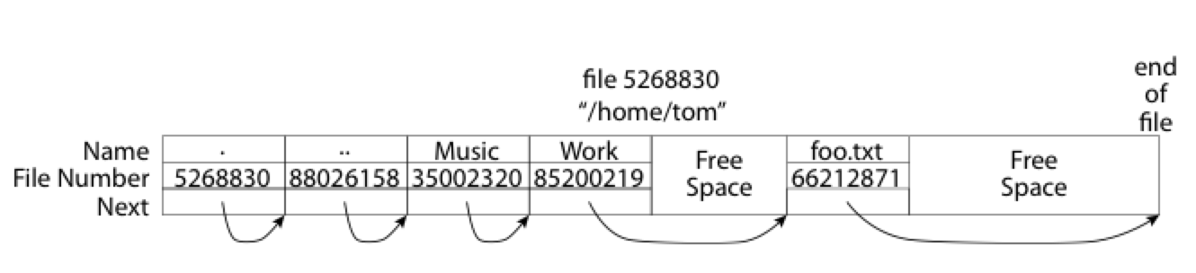
What about the Directory?
Essentially a file containing <file_name: file_number> mappings
Free space for new entries
In FAT: attributes kept in directory (!!!)
Each directory a linked list of entries
Where do you find root directory ( “/” )?

Slide 56
Directory Structure (Con’t)
How many disk accesses to resolve “/my/book/count”?
Read in file header for root (fixed spot on disk)
Read in first data block for root
Table of file name/index pairs. Search linearly – ok since directories typically very small
Read in file header for “my”
Read in first data block for “my”; search for “book”
Read in file header for “book”
Read in first data block for “book”; search for “count”
Read in file header for “count”
Current working directory: Per-address-space pointer to a directory (inode) used for resolving file names
Allows user to specify relative filename instead of absolute path (say CWD=“/my/book” can resolve “count”)

Slide 57
Big FAT security holes
FAT has no access rights
FAT has no header in the file blocks
Just gives and index into the FAT
(file number = block number)

Slide 58
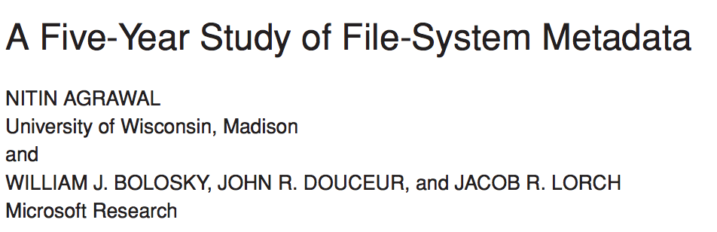
Characteristics of Files
Most files are small
Most of the space is occupied by the rare big ones

